Slide 1
Forecasting the Volume and Effects
of Cattle Farming
Gregory Buckmaster, Gary Chen, Nick Granozio, Katie Pierce
Syracuse University iSchool, IST-718
Winter 2023

Slide 2
Project Overview
Improvements in agricultural sustainability can lead to better climate change outcomes, which would then continue to support efficient agriculture. In other words, less sustainable agriculture which negatively impacts the climate will continue to decrease agricultural output in the future.
This project intends to research and analyze relationships between different modes of agriculture and their potential impact on the environment.
The focus will be determining whether there are recommendations for more efficient (highest yield, lowest waste) types of agriculture. The outcome will provide an answer to how the world can create sustainability that offsets both population growth (increased demand) and future resource limitations.
Notes:
Placeholder for Introduction, background from Project Proposal (assignment #1)
Focus on importance to climate and sustainability
Specify the problem, hypotheses

Slide 3
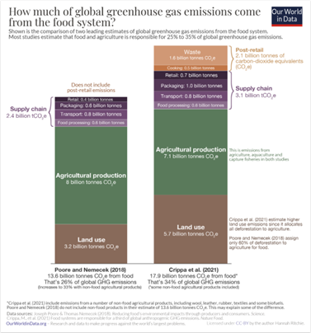
Data Exploration
GLEAM livestock emissions
o Source = Kaggle
o 11 Rows (global average, livestock category)
o 22 Attributes (emissions intensity, production volume)
Food Bank of the World
o Source = Kaggle
o >100k Rows (country per year, over 6 decades)
o 6 Attributes (production value)
GHG Emissions
CO2 emissions by country for 1990 – 2018
193 rows (countries)
28 attributes (for years 1990 – 2018)
Not Categorical / All continuous
Timeseries data
Additional Websources (Our World in Data, Worldometer, Statista)
Notes:
Placeholder for Introduction, more background
Detail on the datasets / journals reviewed
Start to talk about investigation
and data for this analysis

Slide 4
Data Exploration
Mix of categorical & continuous data
Detailed breakdown by commodity and emission type
Bucketed by Continent rather than Country
NOT timeseries
GLEAM
(kg production / emissions)
Link production over time by country per commodity type to establish which has the largest impact on GHG Emissions trends
Make recommendations based on investigation into how some countries seem to have less GHG Emissions per kg/livestock production and therefore more efficient agricultural practices per commodity
Forecast model based on timeseries data to show where we are headed without a change
Continuous data
Total Greenhouse Gas (GHG) Emissions NOT detailed by type or source
Bucketed by Country not Continent
Timeseries Data
GHG / Time
Mix of categorical & continuous data
No direct link to emissions
Bucketed by Country and Commodity
Timeseries Data
Prod / Time

Slide 5
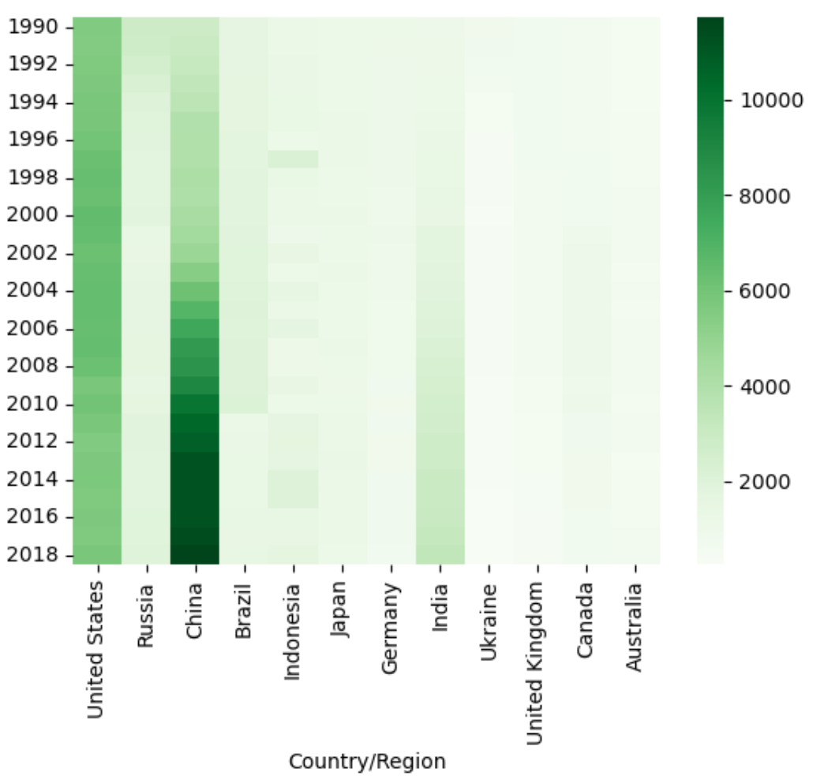
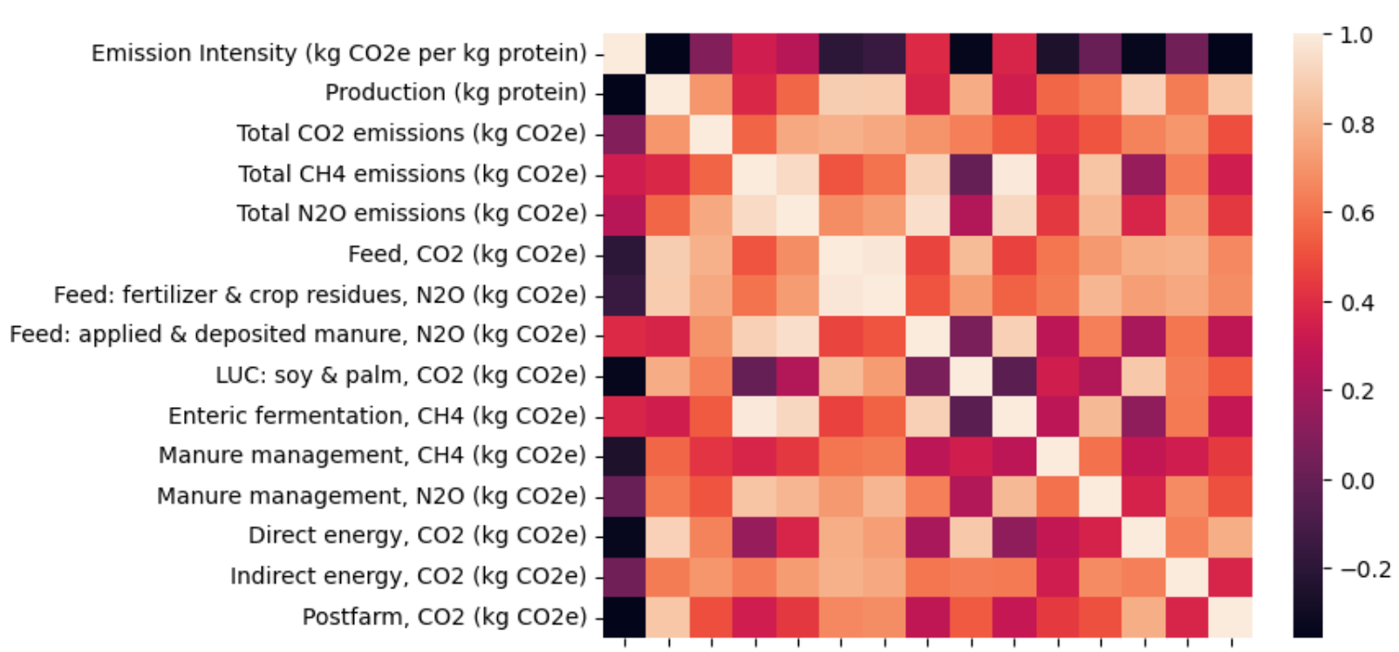
Visualizations and Dataframes #1
Heat maps helped continue narrowing scope and focus by highlighting attributes of interest.
For countries over the years – China, India and the United States
For types of emissions, either in terms of specific gasses or agricultural process by-products,
there were no clear hot spots or cold spots which weren’t easily explained
(Enteric Fermentation = Methane) – Justifying use of overall Carbon Dioxide Equivalents (CO2e)

Slide 6
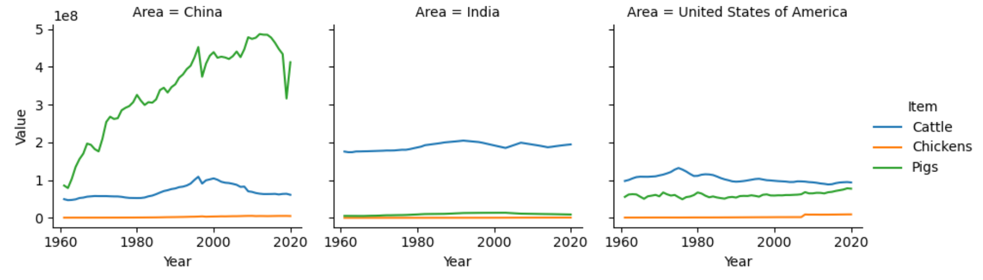
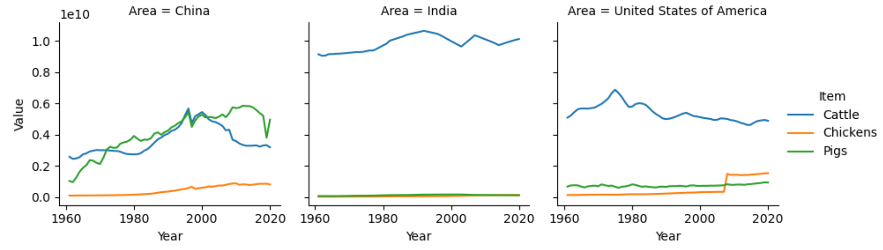
Visualizations and Dataframes #2
Livestock production values by country over time as number of animals raised. (Note: Chickens / 1000)
GHG Emissions per kilogram protein per animal by country over time. (Fully adjusted)

Slide 7
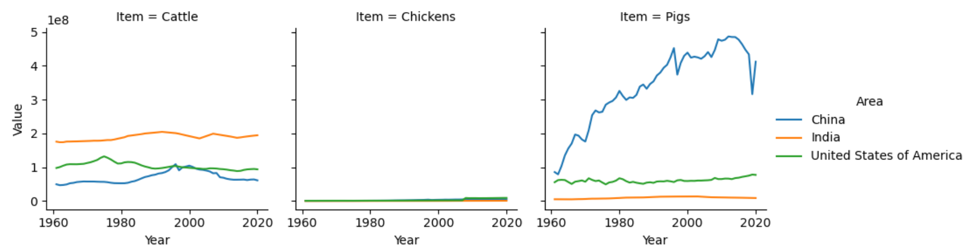
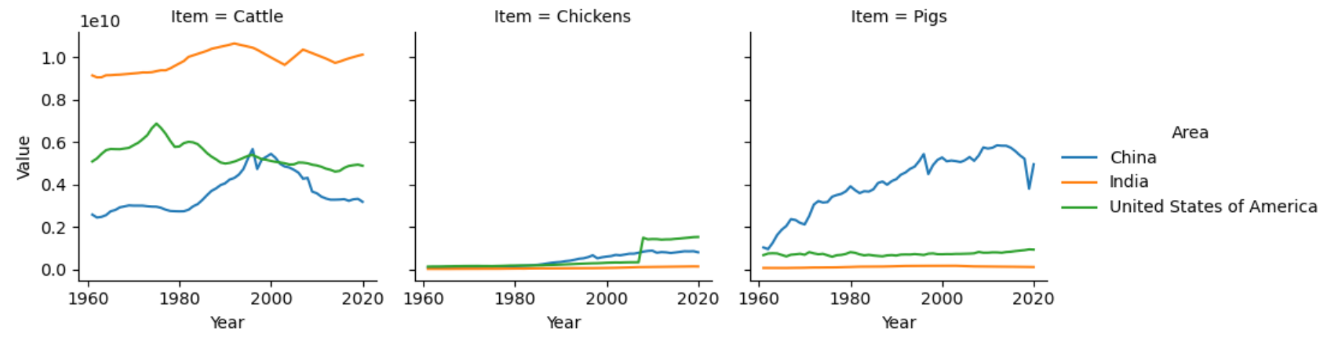
Visualizations and Dataframes #3
Livestock production values by animal over time per country. (Note: Chickens / 1000)
GHG Emissions per kilogram protein per animal by country over time. (Fully adjusted)

Slide 8
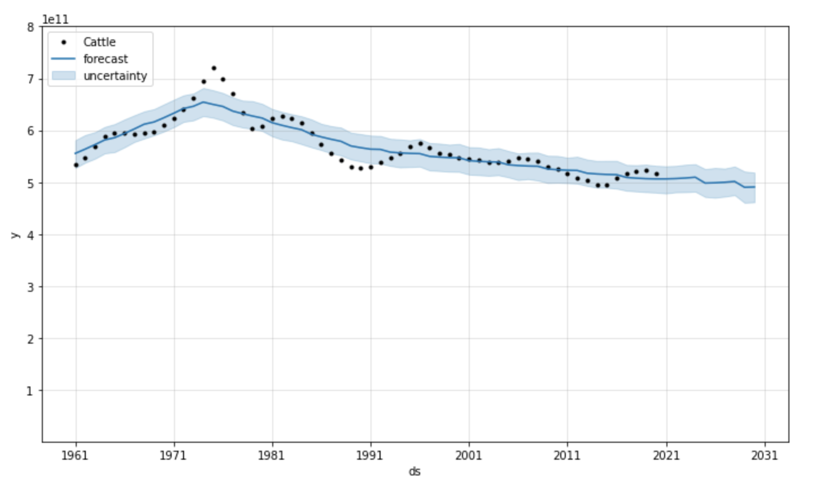
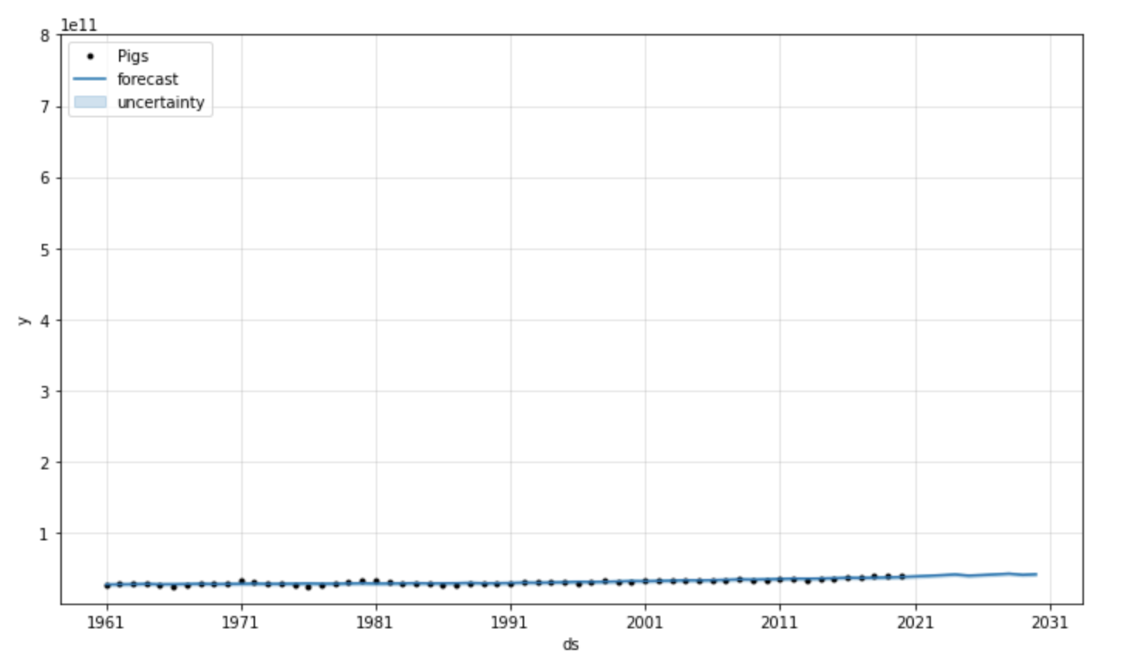
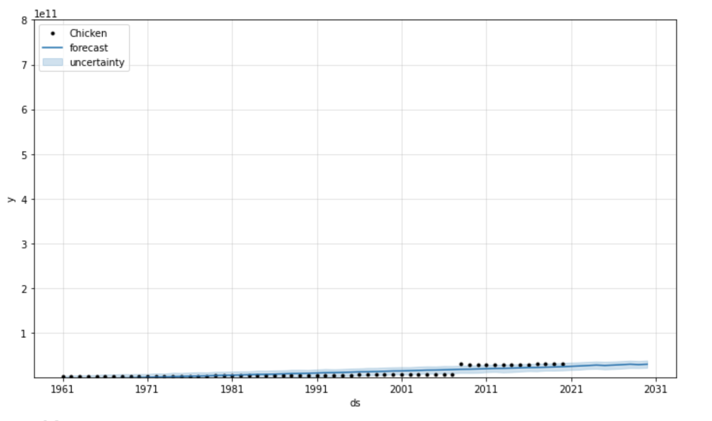
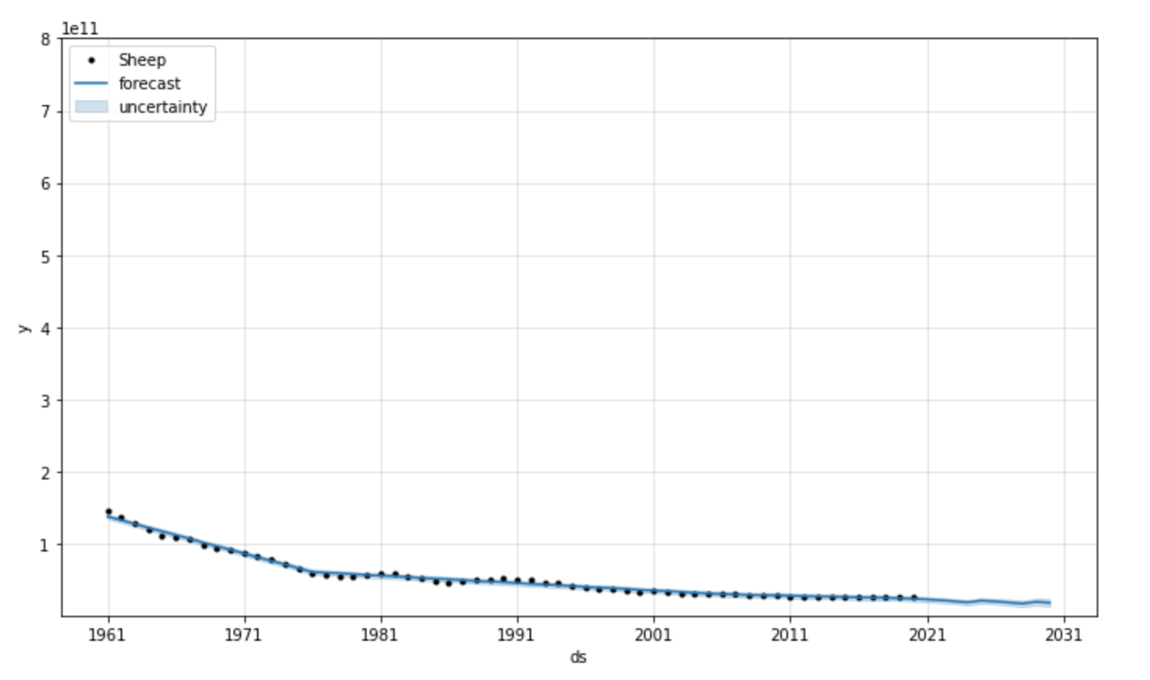
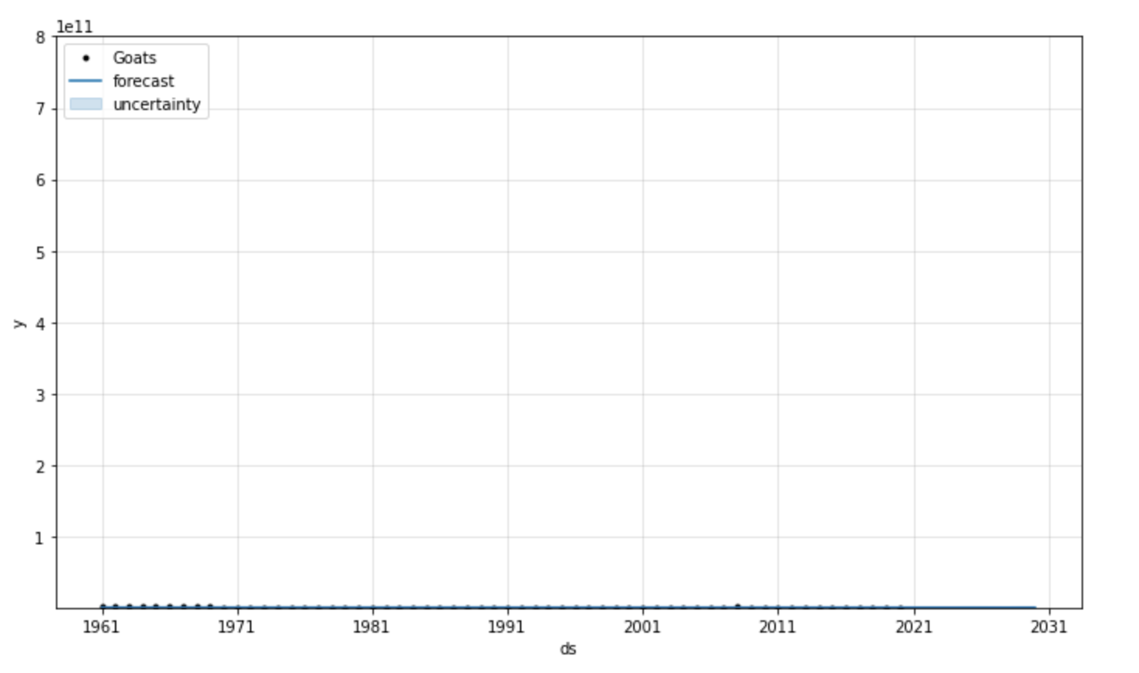
Livestock Forecasts for North America
Cattle
Pigs
Chicken
Sheep
Goats

Slide 9
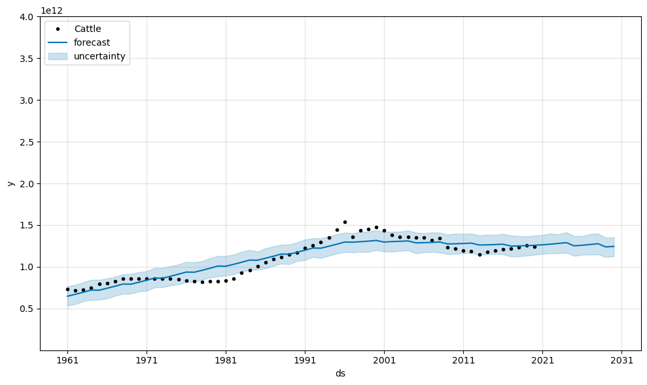
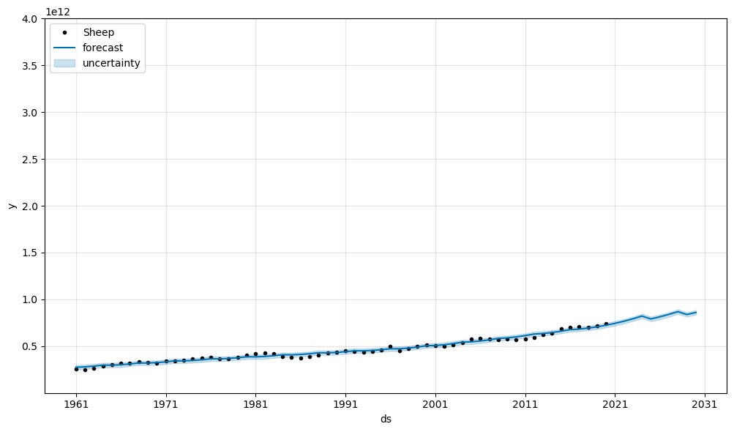
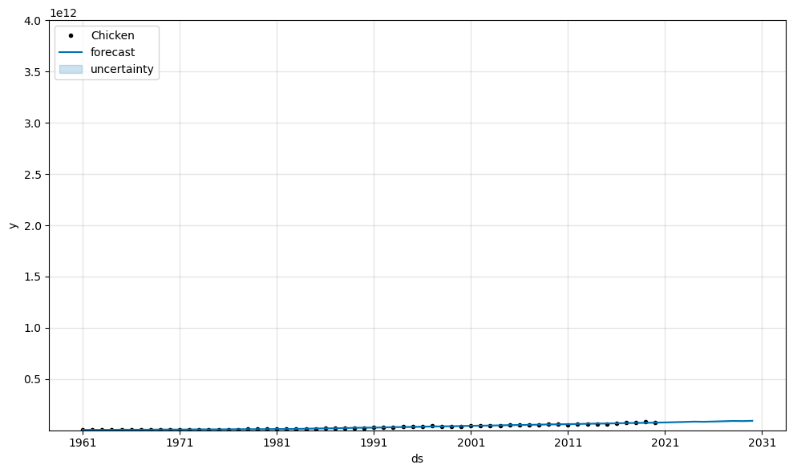
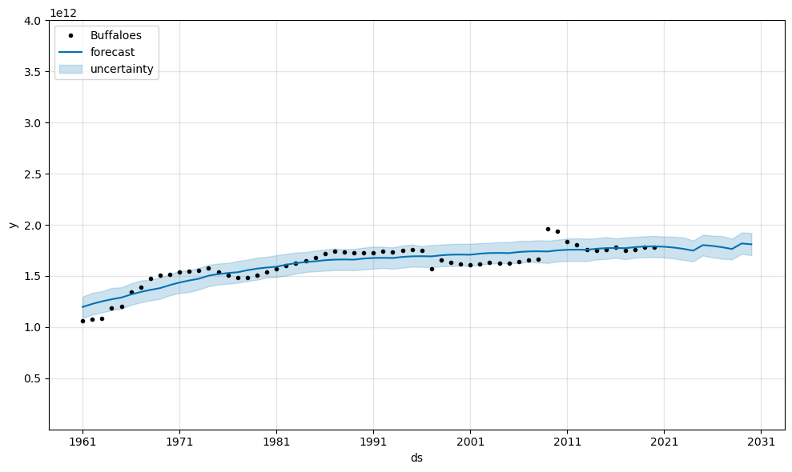
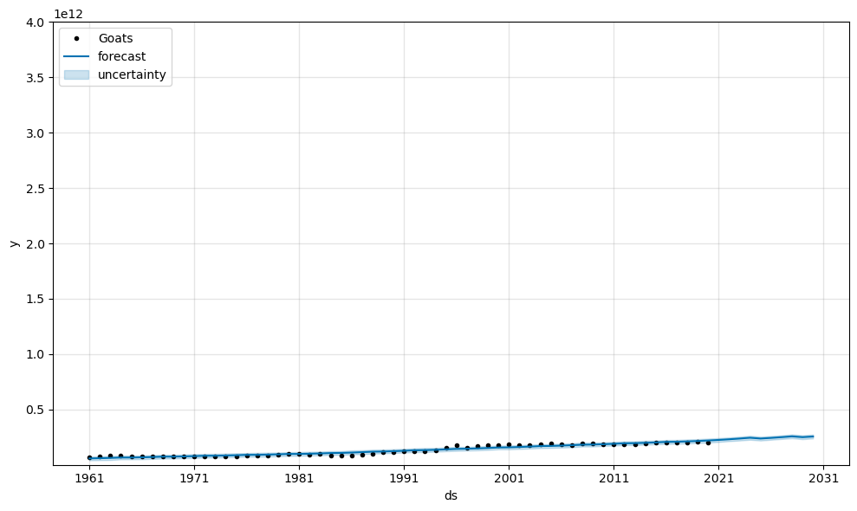
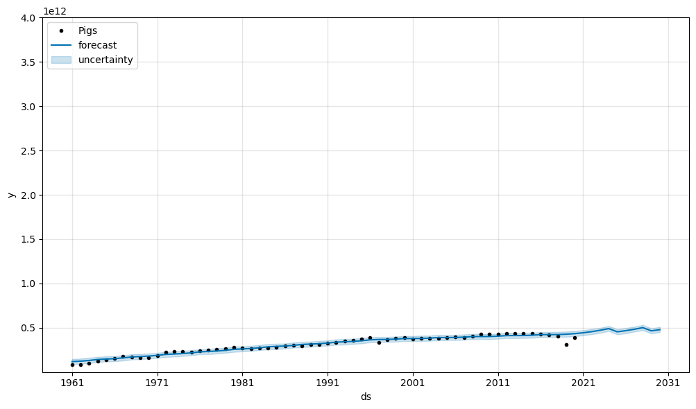
Livestock Forecasts for East and Southeast Asia
Cattle
Sheep
Chickens
Buffalo
Goats
Pigs

Slide 10
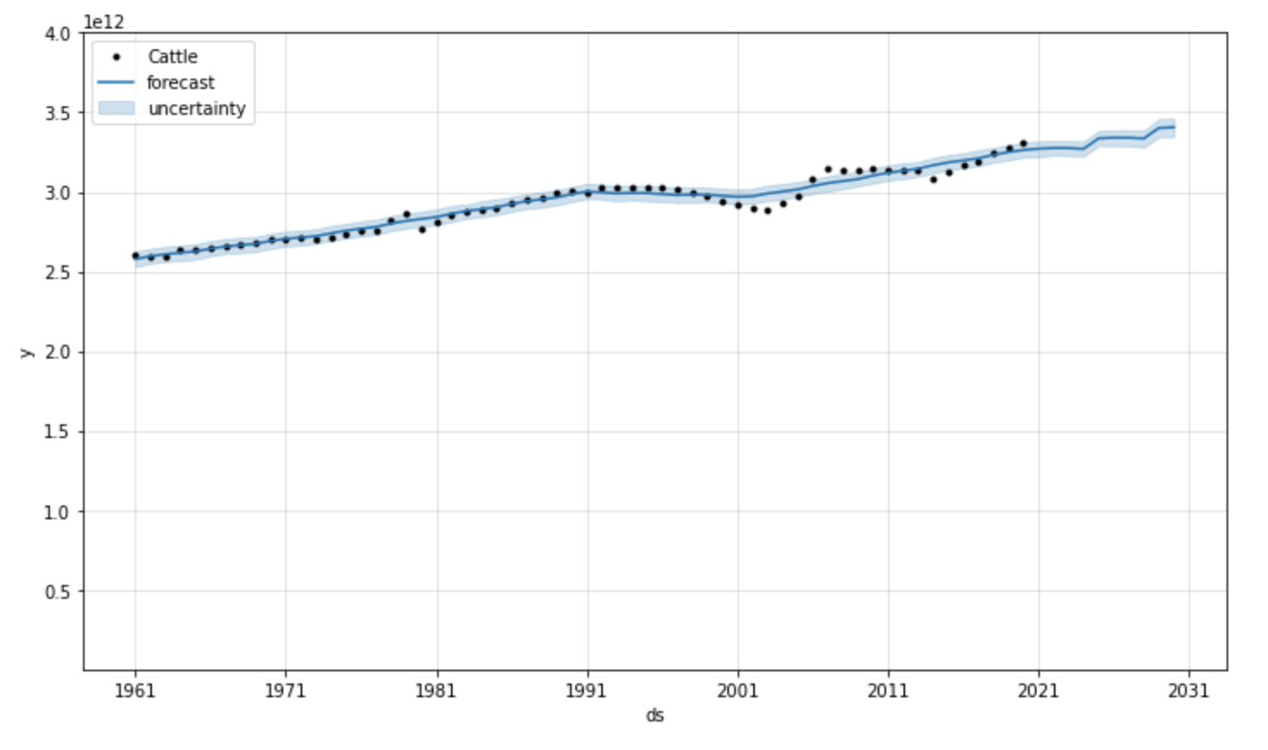
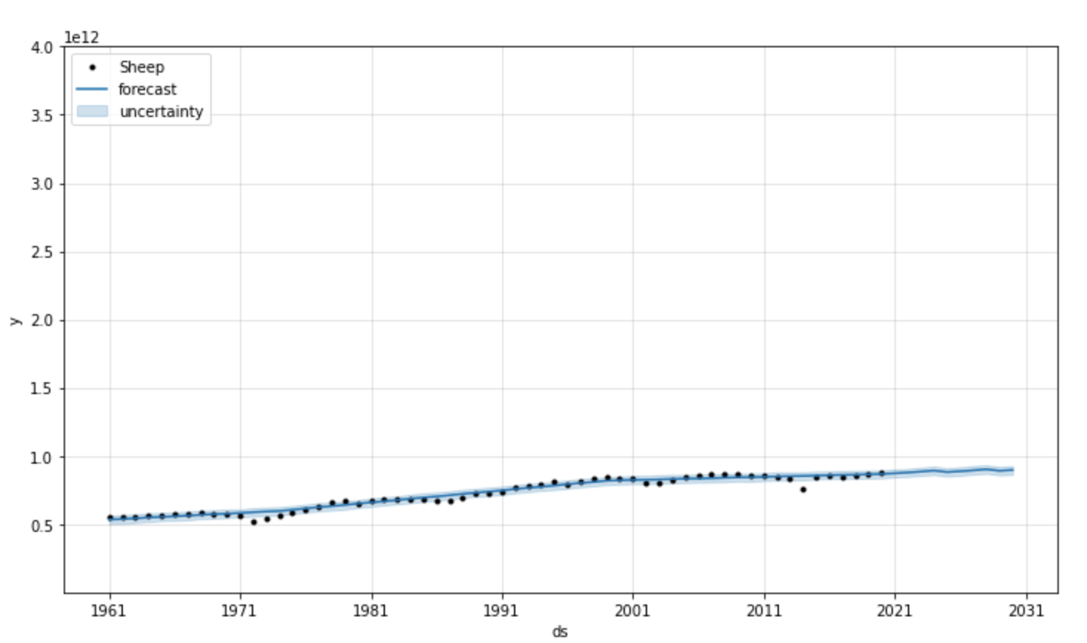
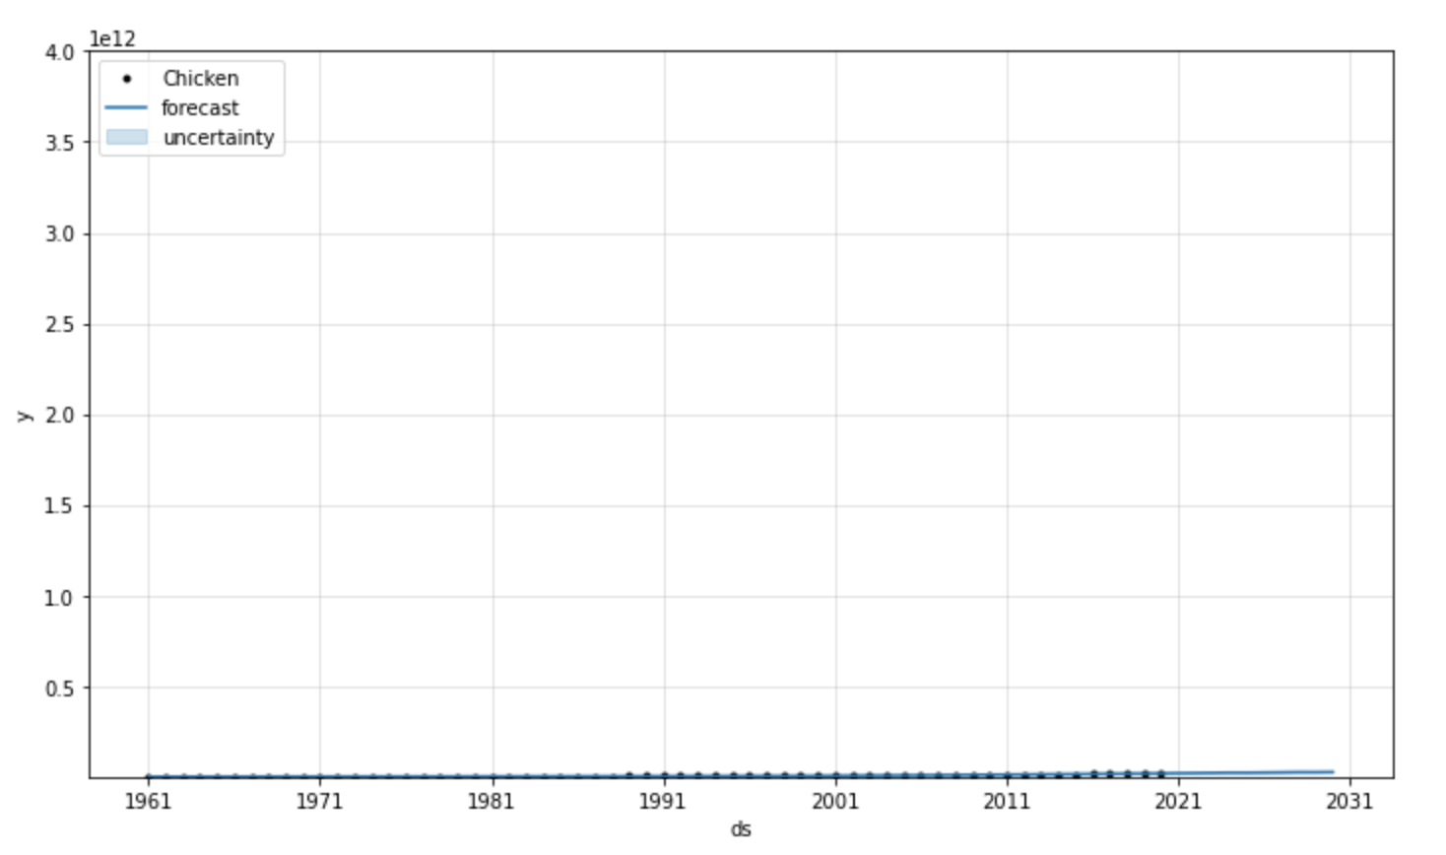
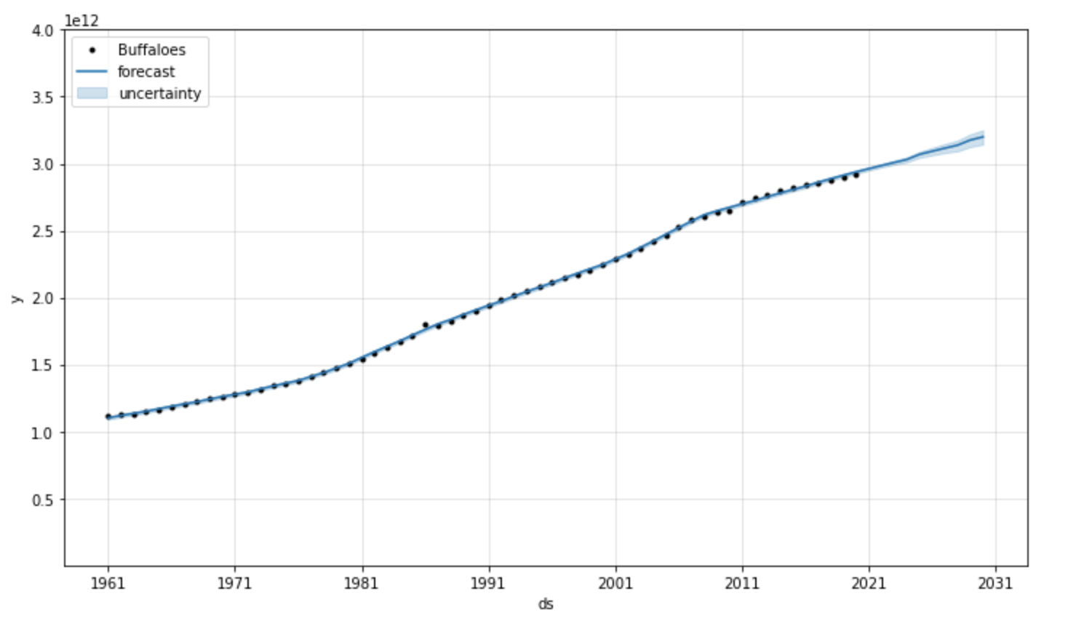
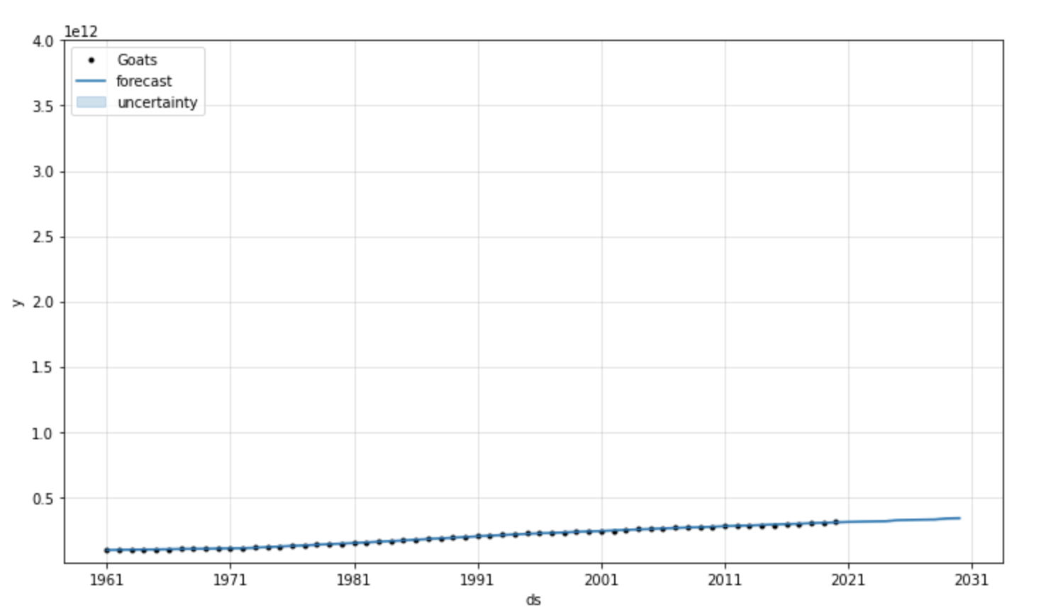
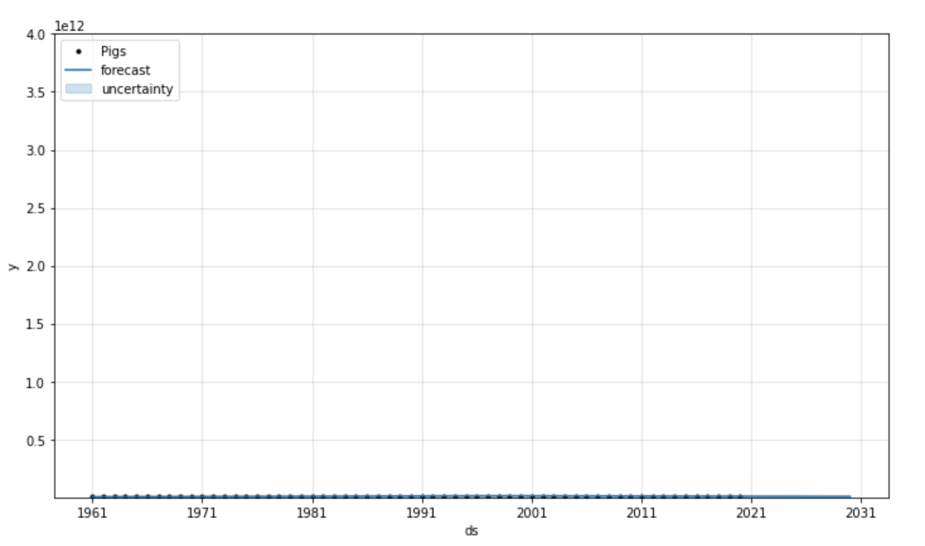
Livestock Forecasts for South Asia
Cattle
Sheep
Chickens
Buffalo
Goats
Pigs

Slide 11
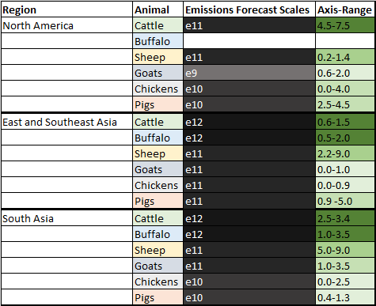
Livestock Forecasts Scale Across Regions

Slide 12
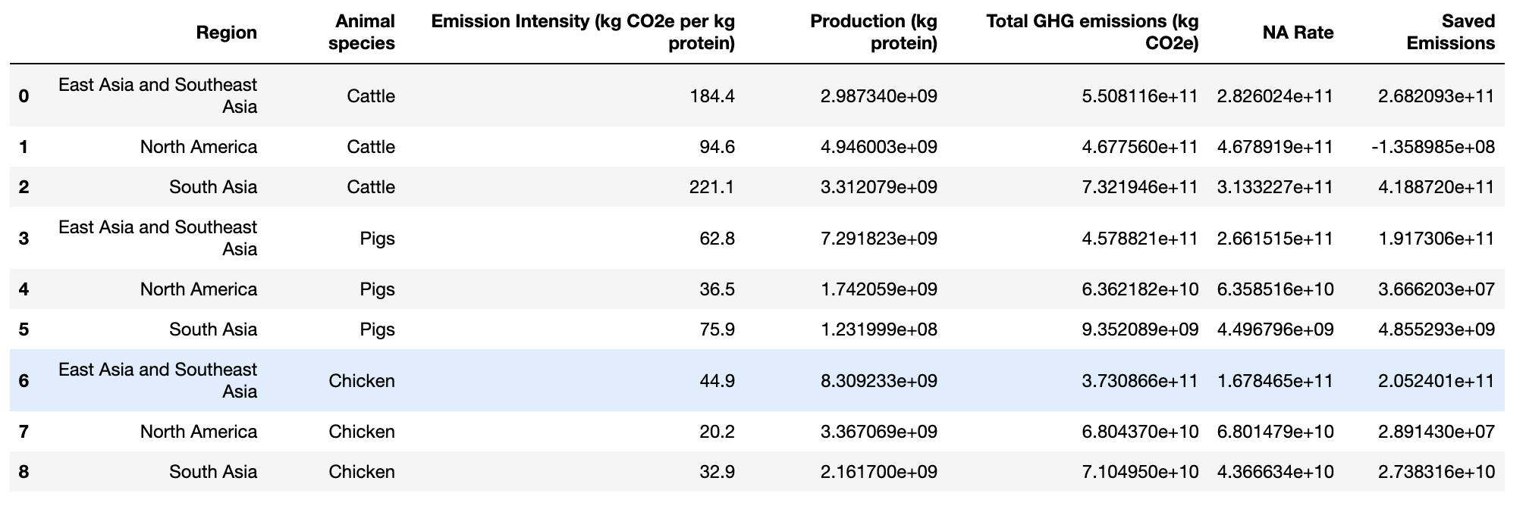
Proposed Collaboration Between Highest Producing Regions
The GLEAM dataset provides emission intensity for each animal production within each region
North America is shown to have the most efficient production for all three major livestock segments
We then calculated each row's updated total emissions if that region used North America's emission intensity (shown in column NA Rate)
This value was then subtracted from the actual Total GHG Emissions column to show the demonstrated saved emissions based on this model.

Slide 13
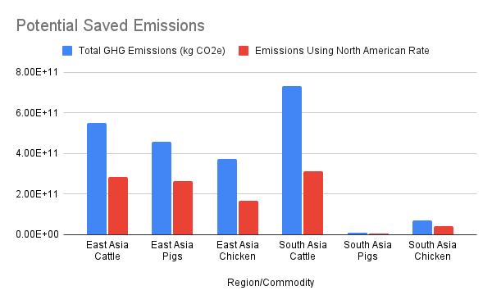
Potential Saved Emissions
East Asia: 665 billion kilograms
South Asia: 451 billion kilograms

Slide 14
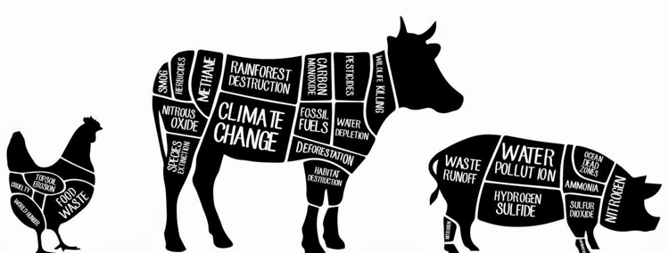
Top Challenges
Complexity of the Problem
Many different attributes influencing GHG Emissions in general
Many different attributes influencing Agriculture production specifically
Not all data in the same units (kg protein vs. stock or head)
Data Quality & Availability
Many different dataset available from various sources
Not all based on the same timeframe or even as timeseries
Not all connected to livestock or agriculture
Regions vs individual country data
Using single country to represent a region (% population)
https://synergies.cofc.edu/animal-agricultures-effects-on-climate-change/

Slide 15
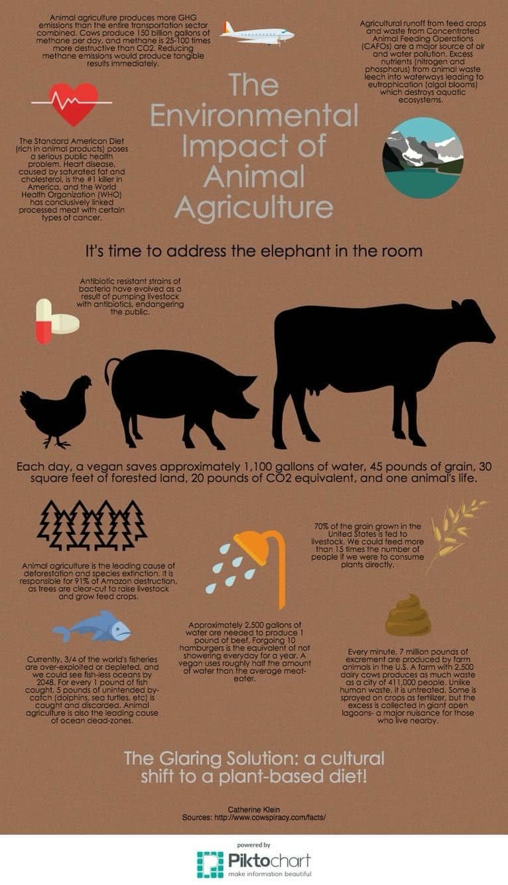
Recommendations
Impact
There is no data to suggest that over the next 10 years agriculture production will decrease in the larger countries around the world
Expectation that GHG Emissions will increase at a similar rate
How to Improve
Sharing best-practices, where feasible, to try and lessen the emissions intensity observed per commodity
North America emission intensity rate as benchmark
Ideal Outcome: India and China could reduce GHG Emissions by 6-8%
Based on cattle alone (2010, non-adjusted rate)
Future Exploration
Connect production to consumption
Example: India produces the most beef, but does not consume it
Investigate impact of local sourced agriculture, farm-to-table aspects

